Slide 1
SENIOR PROJECT MACHINE LEARNING IN CYBER SECURITY
CONTRIBUTORS:
OAKAR KYAW
THET SOE
WILLIAM HANG
OCEAN LU

Slide 2

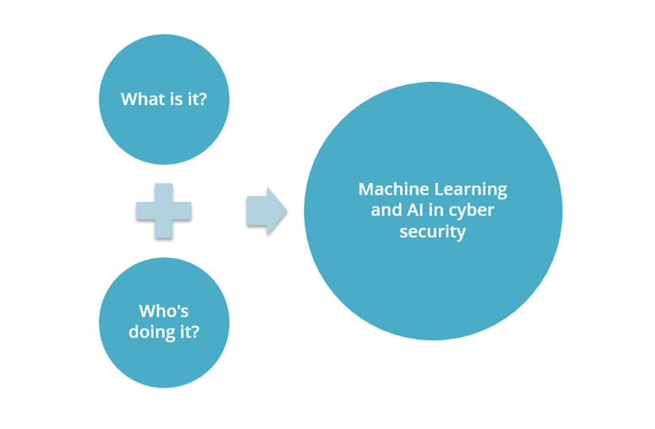
OBJECTIVE
Cyber security is the practice of protecting systems, networks, and programs from digital attacks
Machine learning gives computers the capability to learn without being explicitly programmed
Challenging because attackers are becoming more innovative
In today’s connected world, everyone benefits from cyber defense programs

Slide 3



ABSTRACT
Analyzing Android applications with machine learning
Specifically looked at the XML permissions from Android APK files
Machine learning is utilized to find anomalies to identify malicious behavior

Slide 4
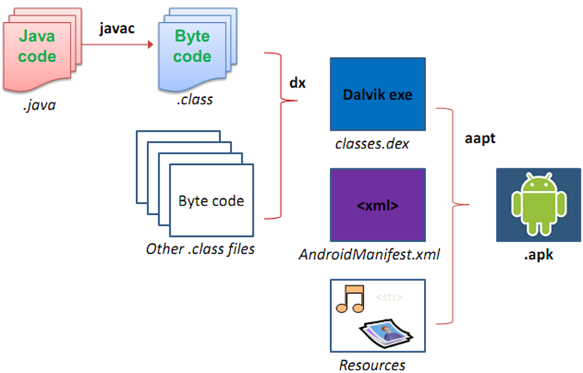
PRIOR KNOWLEDGE: ANDROID APK
Android APK is the package file format used by the Android Operating System for distribution and installation of mobile apps
Android platform uses XML files provide basic configuration of the application (user interface)
AndroidManifest.XML provides essential information: startup class, available activities, and permissions required to run the app, etc

Slide 5
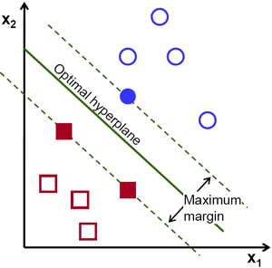
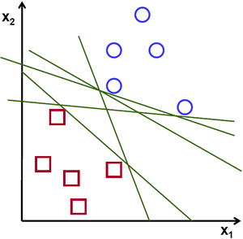

PRIOR KNOWLEDGE: MACHINE LEARNING
Machine learning represented by decision tree, evaluated by accuracy, and optimized search processes
Support Vector Machine (SVM) algorithm: finds a hyperplane n an N-dimensional space (N = # of features) that distinctly classifies the data points
Random Forest (RF): ensembled learning method for classification, regression and other tasks that operates by constructing a multitude of decision trees at training time and outputting the class

Slide 6








DEVELOPER TOOLS
Android SDK Tools: complete set of development for Android
AndroGuard: toolkit that provides reverse engineering and malware analysis
APKTool: utility for reverse engineering Android applications resources (APK)
SCIKIT: machine learning library for Python
Jupyter Notebook: open-source web application
GPlayCli tool: command line tool to search, install, update Android apps
Oracle VM Virtualbox: open-source hosted hypervisor
Santoku: pre-configured Linux environment with mobile forensics, malware, and security

Slide 7
PROCEDURE: APK FILE EXTRACTION
Retrieve benign APK files:
Google Play Store extraction with GPlayCli tool
Used AAPT (from SDK tools in Android Studio) to dump the permission
Retrieve malicious APK files:
Utilized the Oracle VM Virtualbox for safety procedures
Downloaded online sample malicious APK files (from educational sites)
Used AAPT (from SDK tools in Android Studio) to dump the permissions
Wrote scripts
Clean data

Slide 8
PROCEDURE: MACHINE LEARNING
Wrote two scripts
for CSV to clean data
Created the Feature Vector (CSV file)
for pattern processing
Cross validations
to see the fitness of algorithm
Gave data
to train the model and plug into SVM algorithm

Slide 9
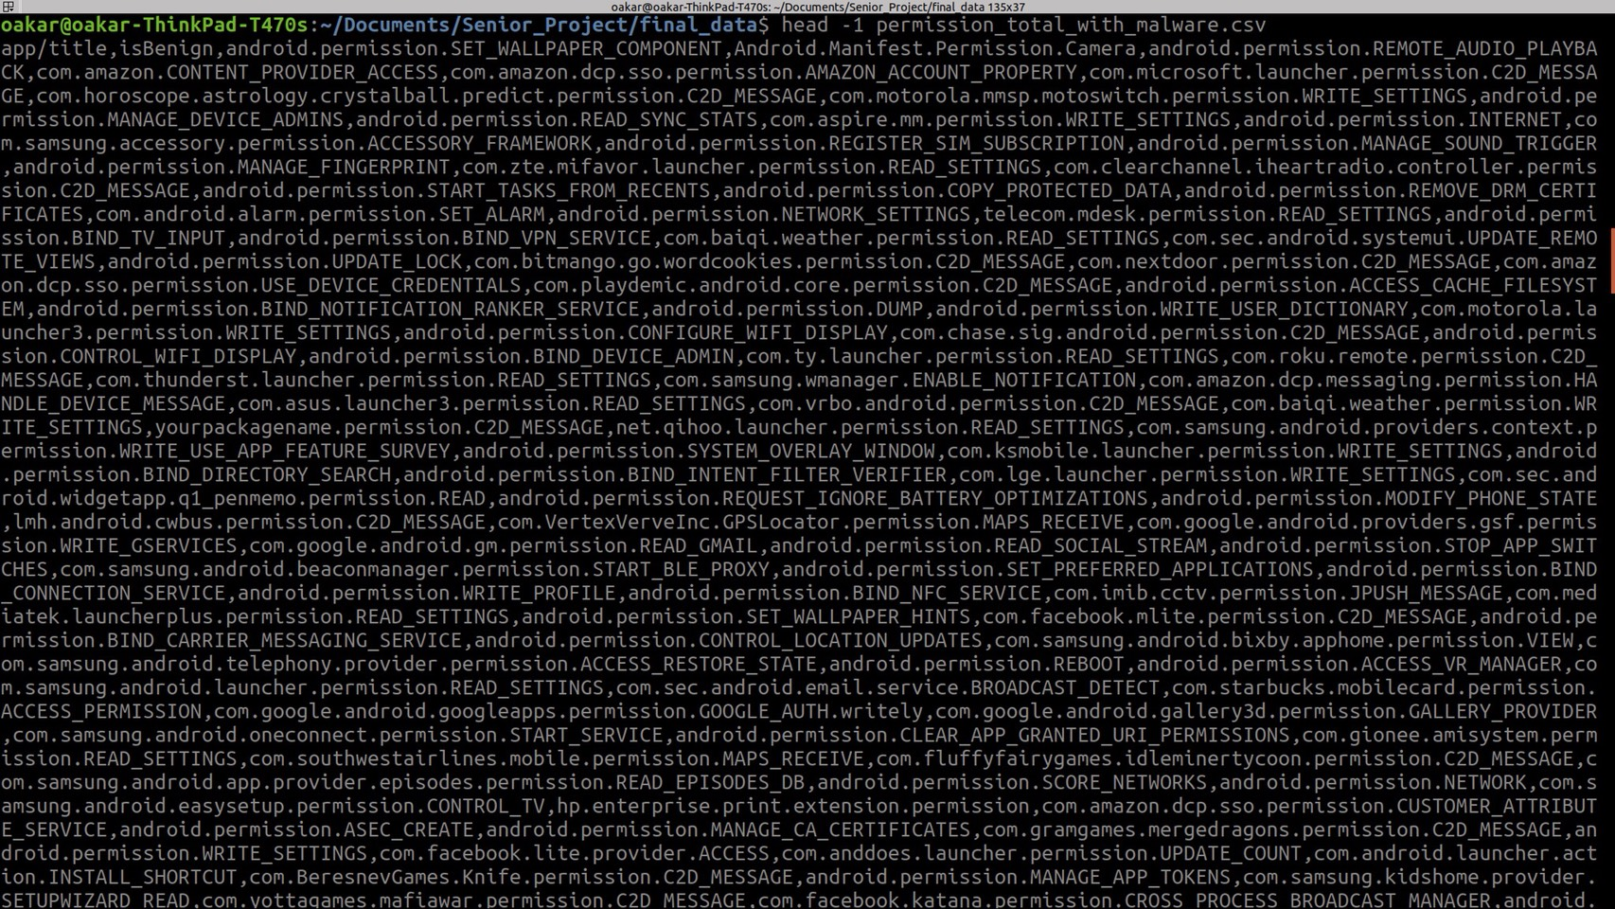
RESULTS: PERMISSIONS EXTRACTED FOR APK

Slide 10
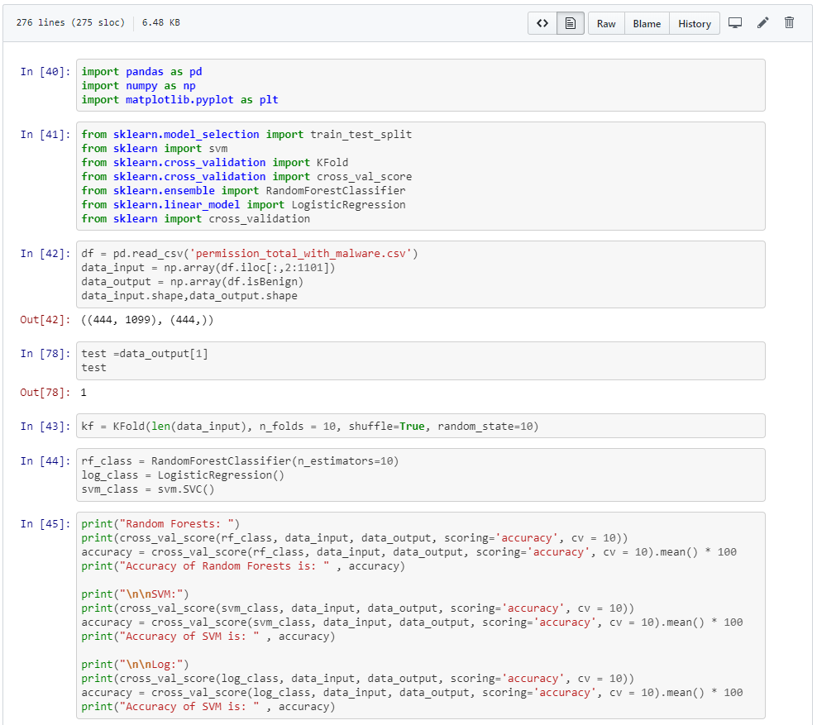
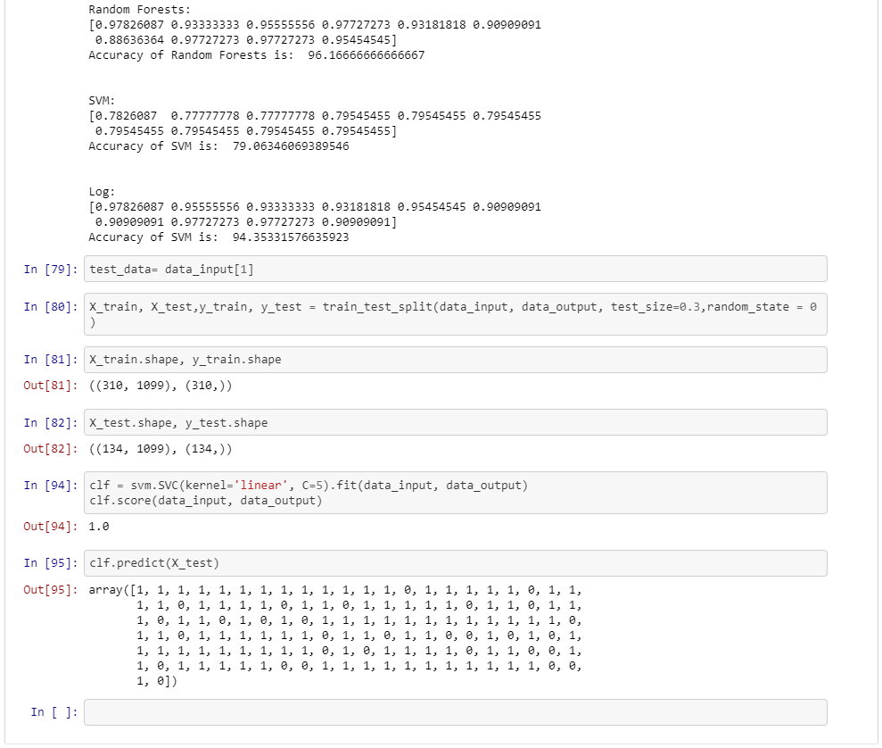
RESULTS: MACHINE LEARNING CODE

Slide 11
CONCLUSION
Satisfied with our results!
[true pos, true neg recap]
Great learning experience—learned how to decompress APK files and extract permissions
How we can improve:
Machine learning in general needs a lot of data
More data leads to more accurate results
Machine learning in cyber security does not necessarily need to solve our problems, but can help by being effective with assistance

Slide 12
THANK YOU FOR LISTENING
QUESTIONS?
REFERENCE: HTTPS://GITHUB.COM/OAKKAR8/SENIOR_PROJECT
HAVE A GREAT SUMMER!

